Slide 1
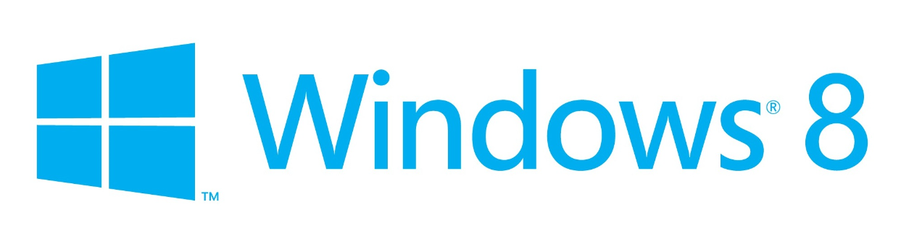
Porting Workshop
Unity to Windows 8 and windows Phone 8

Slide 2

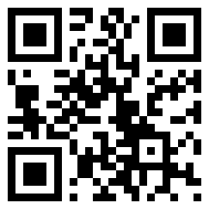
Michael Cummings
Michael Cummings is a Microsoft Developer Evangelist for Maine, New Hampshire, Vermont, New York, Massachusetts, Rhode Island and Connecticut. Talk to him about initiatives around BizSpark, Azure, Windows Phone, and Windows 8 in New England.
Phone: 781-373-8636
Email: cummings.michael@microsoft.com
Web: michaelcummings.net
Twitter: @mcummings
Skype: cummings.michael

Slide 3
Current Promotions
Best App a Month (BAM)
Register your app (or game) with me for BAM to win a Dell Venue Pro Tablet.
Bring your game to Windows.
http://www.wpdevcenteroffers.com/

Slide 4
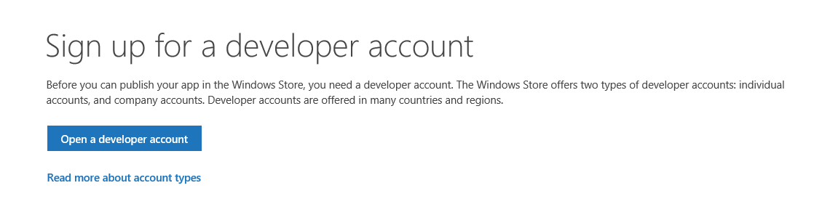
Pre-requisites
Sign up for a developer account: http://msdn.microsoft.com/en-US/windows/apps/br211386
Windows 8: Use dreamspark or bizspark. If you do not qualify for those things, purchase it and start developing.
Visual Studio: 2012 update 4 or 2013 will work. http://www.visualstudio.com/downloads/download-visual-studio-vs
I like to recommend 2012 Express for Phone as it comes with the phone 8 sdk as well. Alternatively you can install
them separately.

Slide 5
Porting Resources
http://unity3d.com/pages/windows/porting
https://github.com/windowsgamessamples/UnityPorting

Slide 6
Common Issues
Compilation
3rd Party Plugins
Support the Platform (snap, switch to another app, share charm activated)
Direct Communication
Keyboards
Shaders
All of this information has been documented on the porting tips guide, along with resolutions.

Slide 7
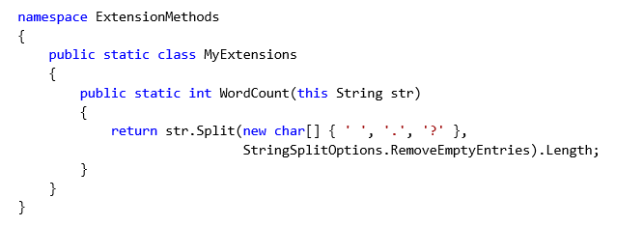
Compilation
The problem is that some namespaces are missing altogether. There are also some instances of missing functions. The recommendation is to create wrappers or use extension methods for missing functionality.
missing types include Hashtable, ArrayList, OrderedDictionary, SortedList, Queue, Stack and a few others.
Unsupported overloads include String.Format
You would then create wrappers for Hashtable and extension methods for String.Format()

Slide 8

Third Party Plugins
A good way to check if a plug-in is compatible is to run it through the http://scan.xamarin.com.
If a binary plugin is not compatible, email the plugin owner as well as myself (dacrook@Microsoft.com) and Jaime (jaimer@microsoft.com)
If a plugin is not compatible but has source code available with it, we simply need to implement any of the missing namespaces/classes as well as functions.

Slide 9

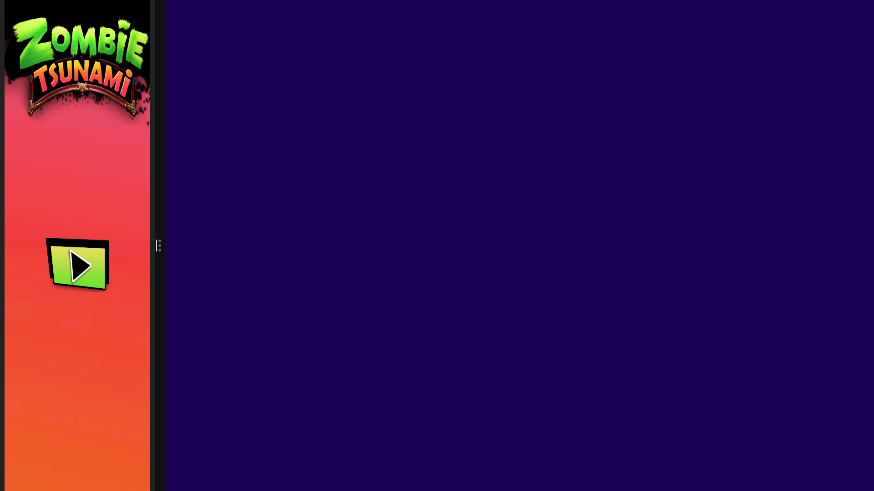
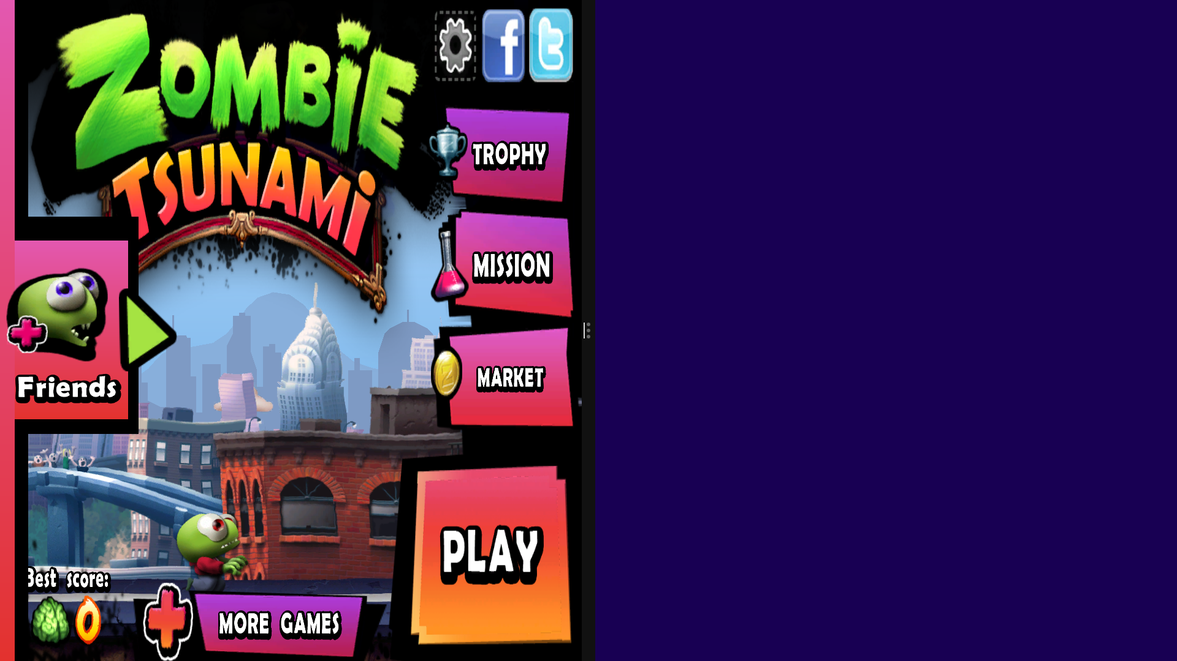
Support the platform
Snap View (registering this event and dealing with it) and various states
Charms (Share, Search, Settings).
Splash Screen
Various Logos and Badges
Remember the many different computer configurations (touch, keyboard & mouse, accessibility)

Slide 10
Direct Communication
From within your Unity code: create delegates (or actions) that your hosting environment can have access to
Example:
Public Static MadeUpClass() {
//make a blank implementation to avoid errors
public static Action doStuffFromWinRT = {};
}
From your visual studio code: set those functions to something you want.
Example:
void HandleClick(sender s)
{
MadeUpClass.doStuffFromWinRT = { exit(0); SomeOtherPredefinedFunctionInWinRT(s); }
}

Slide 11
Direct Communication Cont.
AppCallbacks.Instance.InvokeOnAppThread(() =>
{
//do things from unity context here
}, false);
AppCallbacks.Instance.InvokeOnUIThread(() =>
{
//do things from windows context here
}, false);
This is typically used for plugins
Things to invoke on UI Thread: Setting up event handlers for Search, or Charms. Great for plugins.
Things to invoke on AppThread: Calling of delegates that exist in Unity when you have a handler triggered.

Slide 12
Direct Communication Cont. Cont.
Use #if UNITY_METRO && !UNITY_EDITOR to ensure your gateway classes and any code that makes use of them is only executed in the context of a Windows Store run.
Note: You can also use UNITY_WINRT to cover both Windows Store and Windows Phone 8 or you can use UNITY_WP8 for just Windows Phone 8.

Slide 13
Keyboards
Make sure you read page 20 of the porting documentation.
Essentially:
If there is a physical keyboard present: GUI.TextField and GUI.TextArea work great
If not, the expected behavior if you click on a field is for a soft keyboard to appear. To achieve this in Windows, you will need to compose one from windows native xaml and show/hide it using the direct communication techniques discussed above.
Note that for extremely high resolution devices Windows changes the resolution of input buttons to ensure they are clickable (think nokia 1020 type devices). To help with that…
Windows.Graphics.Display.DisplayProperties.ResolutionScale property. If the value is Scale100Percent, then it is a 1:1 ratio, at Scale140Percent, then a XAML unit is going to be 1/1.4 the Unity scale, and at Scale180Percent, it will be 1/1.8 scale.

Slide 14
Shaders
(Unity main menu -> edit -> Graphics Emulation)
When your build target is set to Windows Store App, the graphics emulation level choices are:
DirectX 11 9.3 (shader model 3)
DirectX 11 9.1 (shader model 2) No fixed function. This feature level is used for Surface RT first generation devices, so it is recommended that you support down to this level.
If you write your own shaders, keep in mind that semantics are required on all variables passed between shader stages.

Slide 15
Shaders Cont.
struct vertOut{
float4 pos:SV_POSITION;
Float4 scrPos;
};
←Doesn’t Work
struct vertOut{
float4 pos:SV_POSITION;
float4 scrPos: TEXCOORD0;
};
← Works

Slide 16
Shaders Cont. Cont.
Fixed function shaders are not supported for shader model 2.
Unity shaders come in three flavors: surface shaders, vertex and fragment shaders, and fixed function shaders. Surface shaders are not supported for shader model 2.
Fog doesn’t work on devices with feature level <9.3>
You need to implement it manually. Unity has shared a sample fog shader at http://files.unity3d.com/tomas/Metro/Examples/MyCustomFog.shader. There is also a couple more fog shaders in the sample provided with this write-up. The shaders are at
/UnityPorting/blob/master/Resources/ShaderIssueExamples.unitypackage

Slide 17
Let the porting begin!

